Slide 1
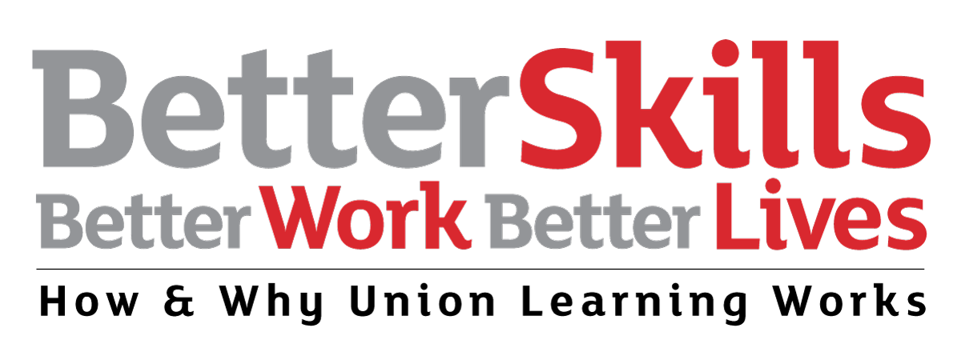

Slide 2
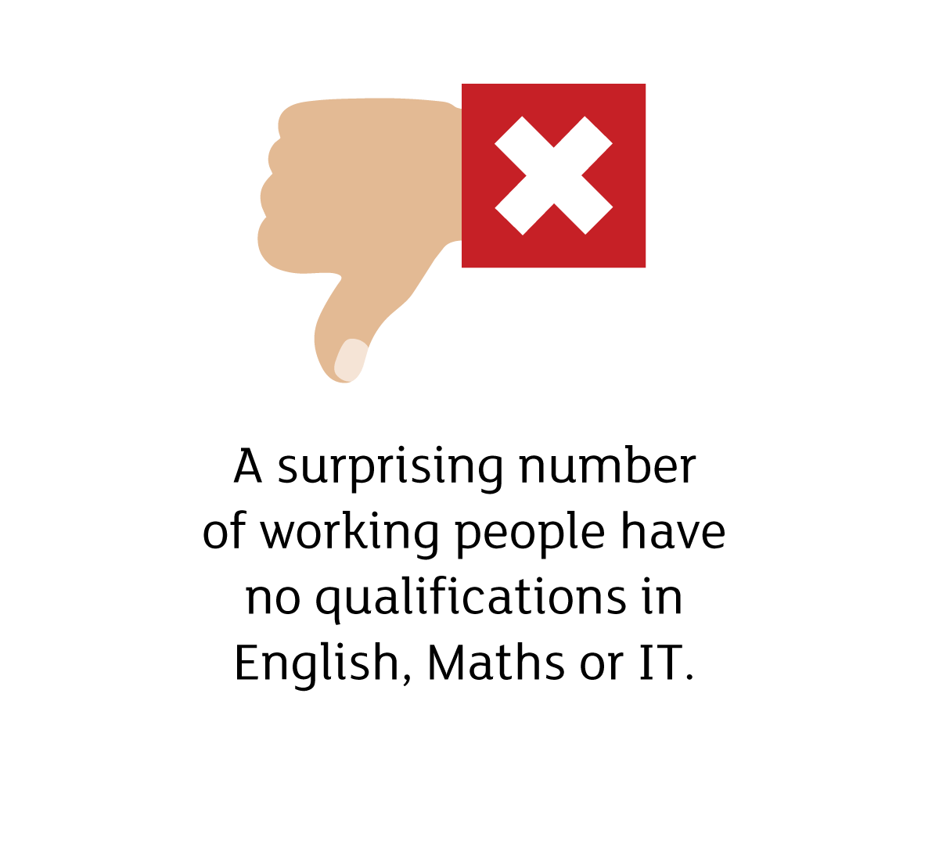





Slide 3
*Research has shown that 18% of adults in Northern Ireland have poor levels of literacy skills and 25% have poor numeracy skills.
**Figures indicate that, as a result, employers in NI could be losing thousands of pounds every year:
smaller employers = £86,000 per year
larger employers = £500,000 a year
*Labour Force Survey Quarterly supplement to the market report July – September 2015.
** https://www.nibusinessinfo.co.uk/content/advantages-essential-skills-training

Slide 4
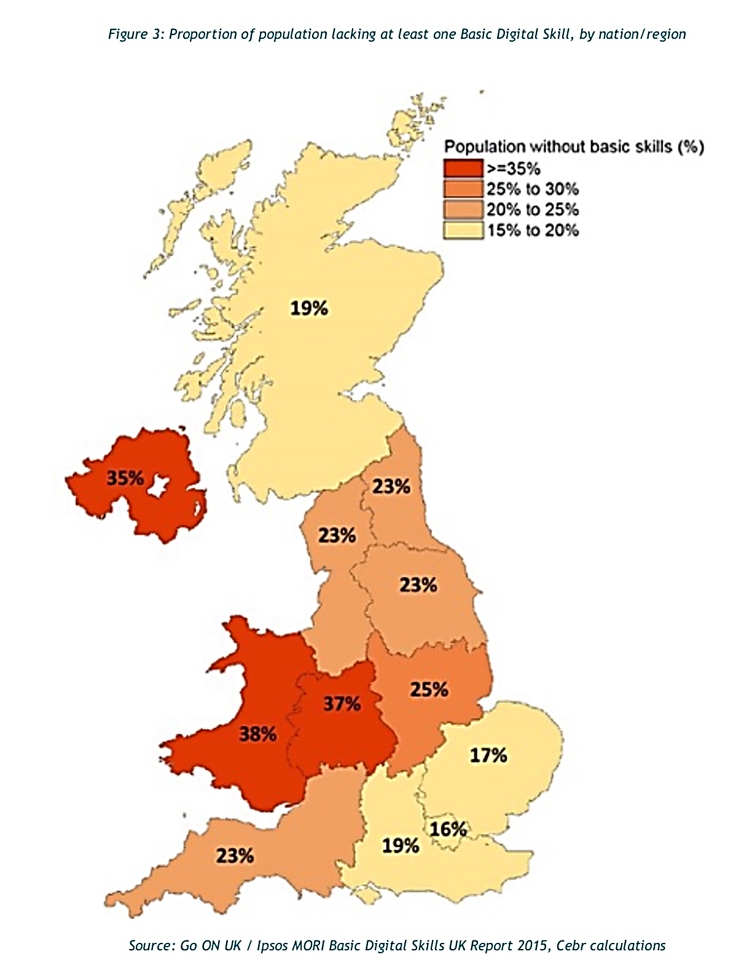

Slide 5


Slide 6
To develop and expand the capacity of the trade union movement as a primary catalyst for increased lifelong learning by its members.
To increase workplace learning by encouraging innovative, union-led partnership projects which leads to workers gaining nationally recognised qualifications.
To widen participation and break down barriers to learning in the workplace by supporting projects which focus on social inclusion and engaging non-traditional learners.

Slide 7


Slide 8
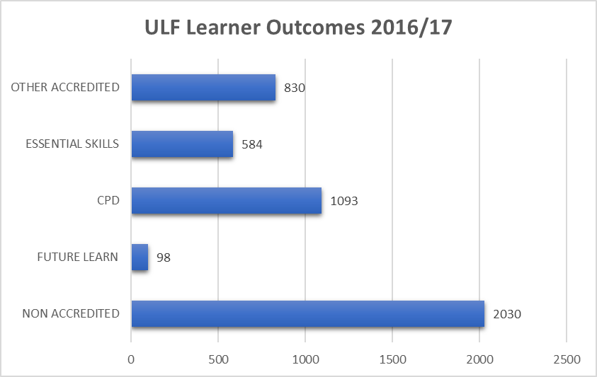

Slide 9


Slide 10


Slide 11
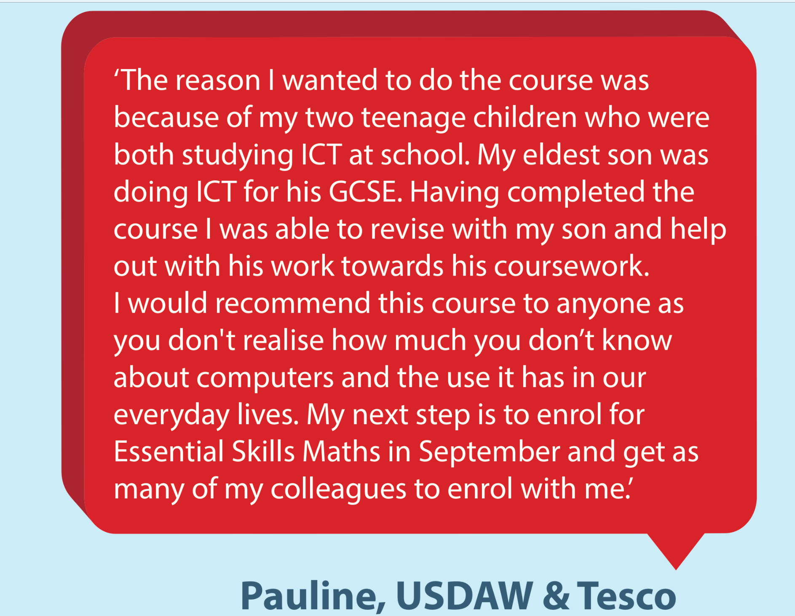

Slide 12


Slide 13

‘ WD Irwins work in partnership with BFAWU to complete Essential Skills courses within the workplace. This benefits not only the employer, but the employee as it greatly enhances their learning and education and up skills employees so that they have opportunity to move up within the business through promotions. In turn the organisation have a highly skilled and educated workforce. This has been greatly received by all employees who completed their Essential Skills and has boosted morale within the work place’

Slide 14

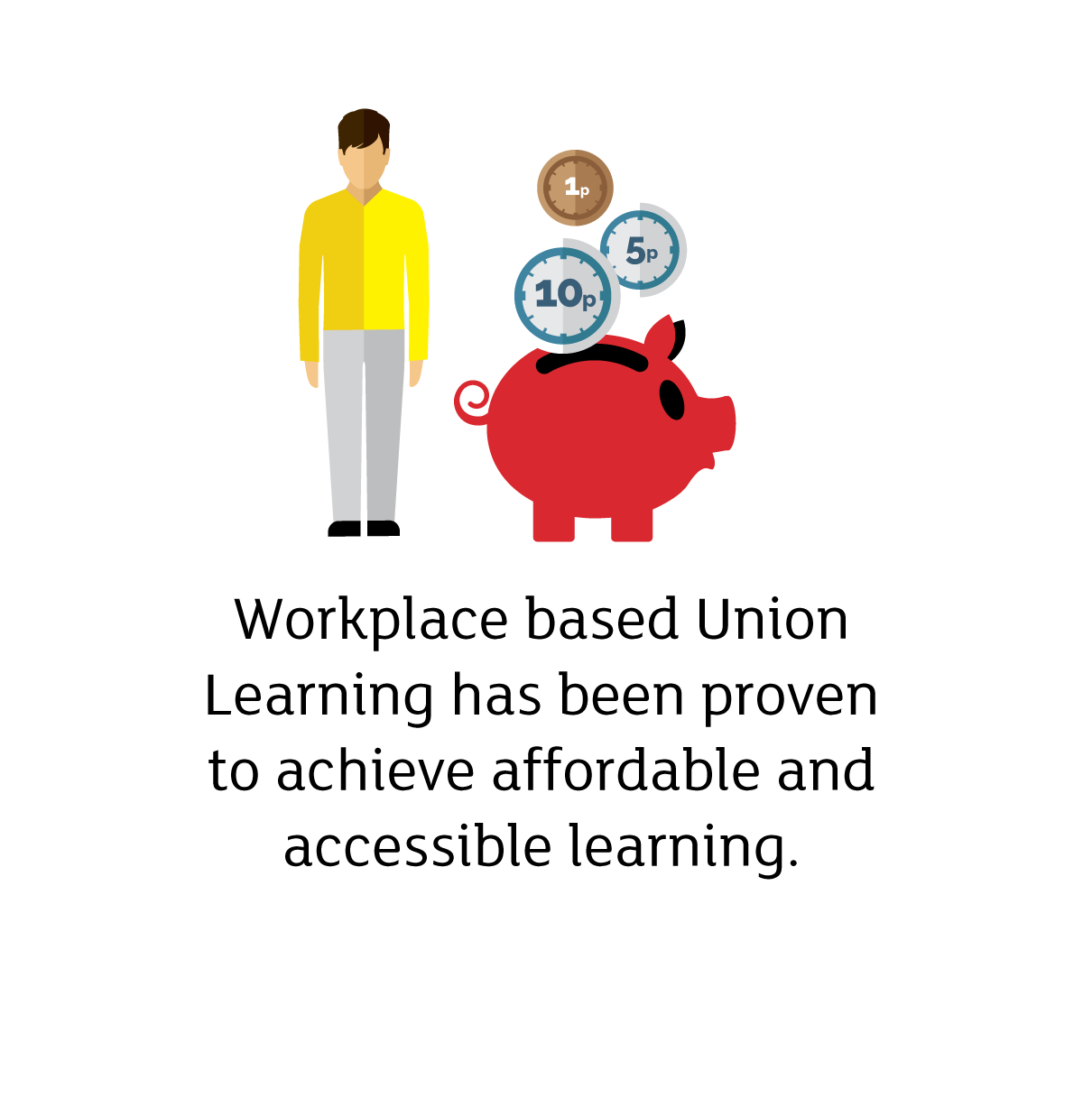

Slide 15


