Slide 1
Barry Neilson
CITB NI
Notes:
Lets start with a quick video

Slide 2
What Do We Mean By
Sustainable Economy?
Going to look at 2 aspects of sustainability:
Energy / Quality within the construction sector
How a skilled workforce leads to a better economic climate.
Are the two things that different ?

Slide 3
Lets look at energy sustainability and the construction sector for a moment.

Slide 4

BIMcert OVERVIEW- The Project
Construction industry
one of the biggest contributors
for CO2 emissions,
resources and energy wastage
All Climate change causes
https://ec.europa.eu/energy/en/topics/energy-efficiency/energy-efficiency-directive
Notes:
Construction industry has a huge impact on the energy efficiency of our world.
Improved energy performance across the Construction Industry is a key driver for Horizon 2020.

Slide 5

Construction industry
needs to improve:
Be more efficient
Reduce wastage and CO2 emissions
Be better at trying to achieve zero carbon
Enable/verify energy efficiency
https://ec.europa.eu/energy/en/topics/energy-efficiency/energy-efficiency-directive

Slide 6
More or specific skills required
Digital construction skills
Supervisory Skills
Core trade Skills
Better communication & management
Teamworking and collaboration
https://ec.europa.eu/energy/en/topics/energy-efficiency/energy-efficiency-directive
Notes:
The key to delivery of energy efficiency is;
Better design
Better collaboration in delivering the design
Better transfer of information
Better execution in terms of understanding the design and quality of construction
The key is better skills
And – digital collaboration

Slide 7





Plan
Design
Energy savings targeted during the design phase
Energy savings designed utilised to achieve energy optimization
Operate
Build
Energy savings through
in-use building performance management
Energy savings achieved through the building operation stage
Notes:
Lets think about energy in terms of the 4 stages of a buildings life;
Click - Plan –Energy savings targeted during the initial concept Client spec’ Potential Energy
Click - Design –Energy savings designed utilised to achieve energy optimization Embedded Energy
Click - Build - Energy savings achieved through the building operation stage – Operational Energy
Click - Operate – Energy savings through in-use building performance management. Sustainable Energy
Each stage relies on clear and effective communication and transfer of information

Slide 8
So what has this to do with a Sustainable Economy?
The project on Energy efficiency has led me to think about skills & learning in a new way.
What is the impact of skills to a workforce?
What is the best way to develop any skill?
Is the development of skills a “one-time-only” event?

Slide 9
Nigerian Experience
Working with Nigerian Agencies on skills development;
Nigerian economy polarised.
Dependant of skilled people from outside the country.
Higher salaries confined to “foreign” workers and a small % of Nigerians
Economy in the doldrums since majority of people have little or no earning (and therefore spending) capacity.

Slide 10
Nigerian Experience
Working with Nigerian Agencies on skills development;
Building a skilled “Nigerian” workforce means that money stays in the economy and helps develop more people with more money and more spending power.
Skilled People = More Sustainable Economy

Slide 11
How does that relate to here?
In Nigeria we are trying to create a system that allows everyone to take a 1st or next step in developing their skills and qualifications.
A big issue is that they cannot take time out for formal education.
Higher salaries confined to “foreign” workers and a small % of Nigerians.
Economy in the doldrums since majority of people have little or no earning (and therefore spending) capacity.

Slide 12
How does that relate to here?
What is so different here?
We have an excellent education system.
There are job opportunities at a variety of levels.
Does that mean there is no comparison?

Slide 13
How does that relate to here?
Do we think that we have all the skills we need for the rest of our working life?
We live in a changing world.
Many of the jobs we will be doing in 10 years time don’t really exist now.
Some say that if you don’t upskill every 3 years you will be left behind.

Slide 14
Sustainable Skills Development for a Sustainable Economy
What’s that about then?
We cant all head off on courses every 10 weeks to catch up.
We all need to take some responsibility for
  Upskilling our people
  Upskilling ourselves
  It’s a shared responsibility

Slide 15

Democratising Skills
Notes:
So what do I mean by Democratising Skills?
We need to think about skills development a bit differently.

Slide 16

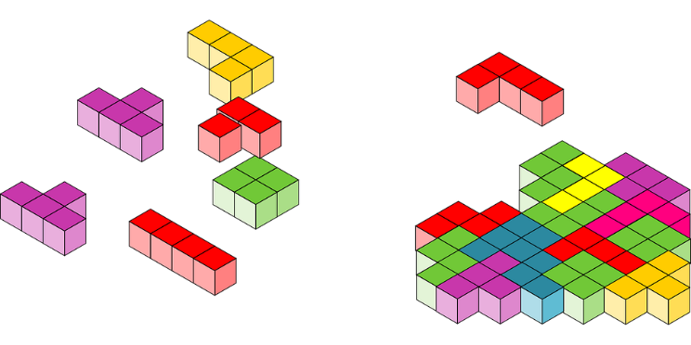

Modules are adaptable to each learners needs and career pathways
Leaners can pick the micro accreditations that suit them
Gain skills required for own needs , combine them to obtain qualification or an unique skillset that allows individuals and companies to develop
Flexibility to build your own personalised skillset
Not a linear progression
Bite sized micro accreditation
Several micro accreditations
( covering specific knowledge and skills)
Notes:
Remember the Bite-Sized note?
(Click) – Think of yourself as “Packman” munching your way through bites of learning in the direction and order that you choose! – You can “bite” into the learning in the way and order that you want or need.
(Click) - The aim is to develop Small learning modules that allow the individual to “pick” the elements or skills they need. “Pick-Up” the skills that suit you and fit them together for your individual needs.
(Click) - The idea is that you can make up your own course collecting skills and credits as you go and as you need them.

Slide 17
How
Learning needs to be accessible.
Learning needs to suit the learning style of the person.
Learning needs to fit in with work and life
Learning needs to be “Blended”

Slide 18
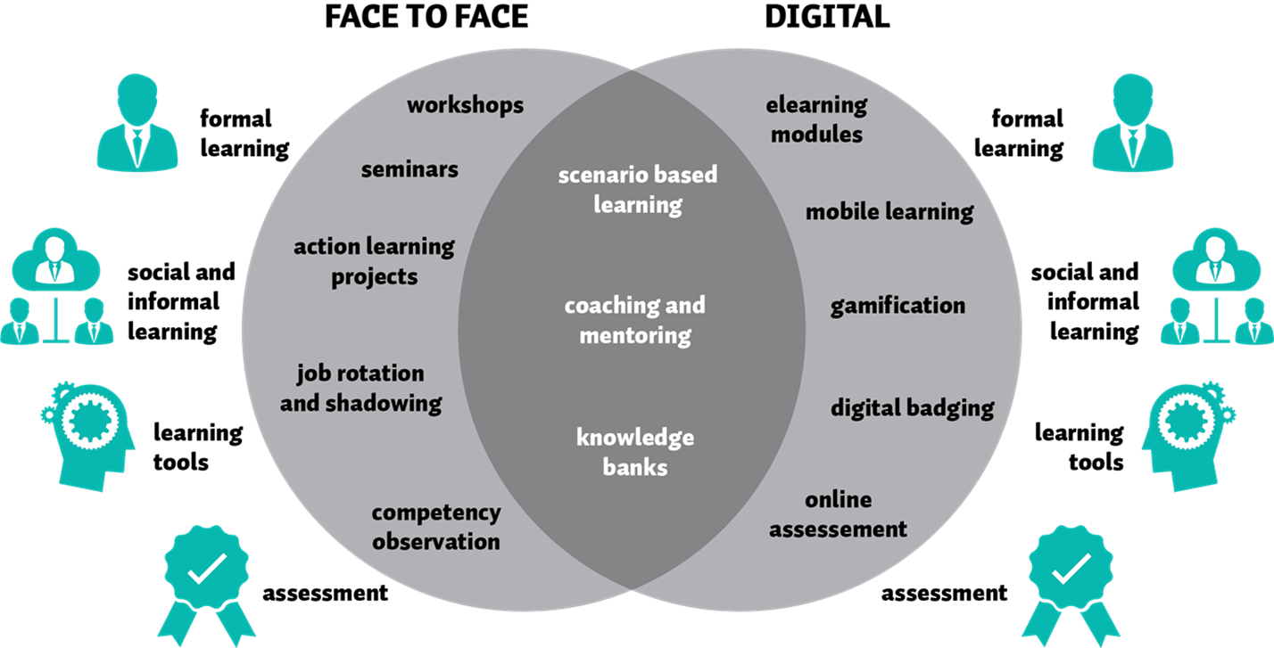
Blended Learning
Notes:
Can we achieve this?
From the research and work of the BIMcert project we believe that a focus on blended learning can help.
Different methods of delivery / different ways of accessing learning materials
Focus on learning styles as much as the content of the learning needed.
Thinking about how and where we deliver learning
Providing access to everyone to learn what they need to know – and provide a route to improve their digital skills

Slide 19
Democratising BIM
Notes:
Democratisation is not just about everyone getting the skills – its about all in the industry coming together to make sure we have a route for people to get them
Working with training and delivery partners from across the industry to provide a blend of training delivered in various ways and pitched at different levels to suit industry needs.
For me, CITB NI’s involvement and support for this event is only a first step in working with industry

Slide 20
What If We All Had The Right Skills And Access To Upskilling?
As individuals – developing ourselves:
Better quality in our activities – better chance of getting it right if we are skilled.
Better productivity by not having to fix things not done right in the first place.
Better understanding of everyone's job.
Better management & communication.

Slide 21
What If We All Had The Right Skills And Access To Upskilling?
As a Business – delivering for our clients:
Better quality in our activities – better chance of getting it right if we are skilled.
Better productivity by not having to fix things not done right in the first place.
Better understanding of everyone's job.
Better management & communication.

Slide 22
What If We All Had The Right Skills And Access To Upskilling?
As an Economy – delivering for our population:
Access for all to develop their skills and build a stake in the economy.
Ability to develop to the level of ability or ambition.
Flexible people and business – able to adapt to changes.
A sustainable economy built upon combining the skills and abilities of us all.
The one constant will always be change.

Slide 23
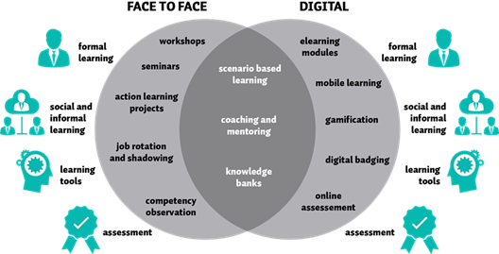
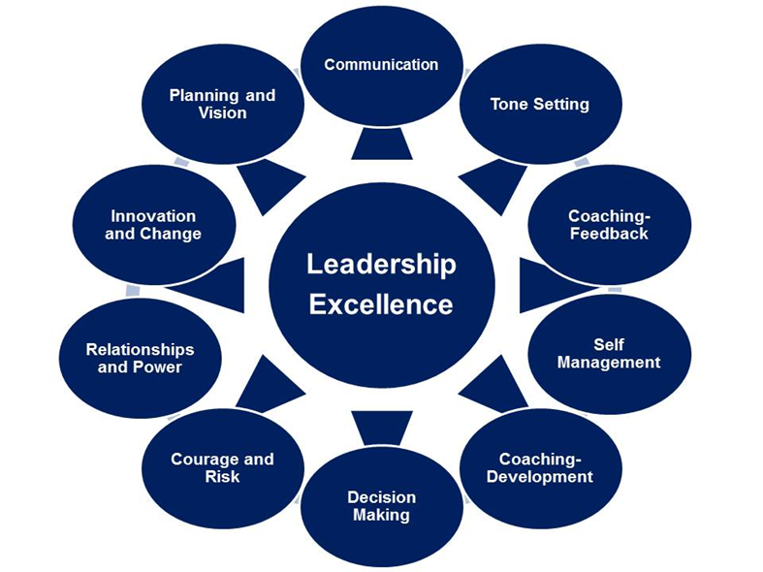
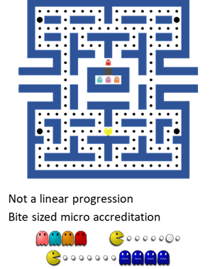
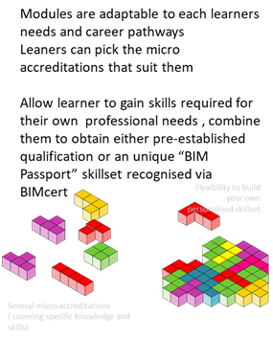
Building Skills Builds a
Sustainable Economy

Slide 24

What Do You Think?

