Slide 1

Terry Park
Head of Further Education Delivery
DfE

Slide 2
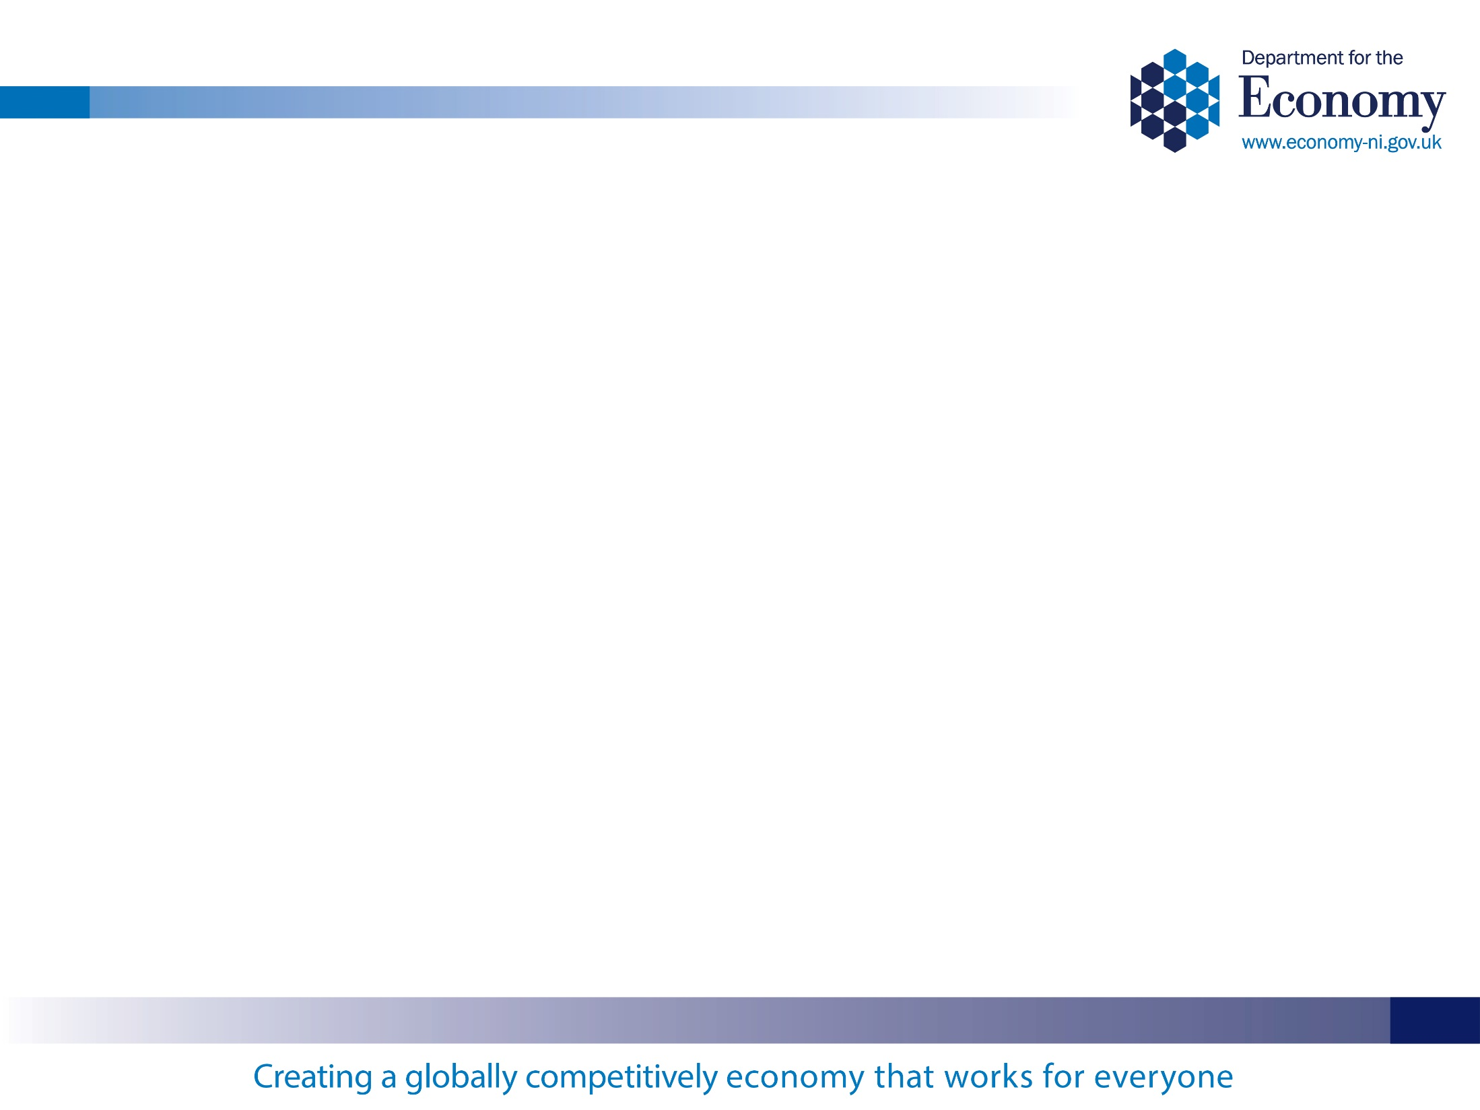
FE Strategic Context – A Look Back
Skills Strategy 2020
Skills Barometer
FE Means Success
Draft Industrial Strategy Pillar 2
Draft NICS Delivery Plan
Notes:
Central to the roadmap for Further Education are the ambitions and outcomes set out by the previous NI Executive for our society in the draft Programme for Government (PfG).
The draft Industrial Strategy provided further detail on how a number of those ambitions will be realised.

Slide 3







Skills and the Programme for Government
Programme
for
Government
Notes:
Its also important to note the political and strategic contexts around all of this. The executive is recently restored, and there is an ambition to get the new programme for government in place for april to run for a year. The work we do will contribute to many of the outcomes, in particular outcome 6.
Additionally the executive wants to put in place a new multiyear PfG from April 2021 and they aim to consult on it later in the year. Similarly, the draft industrial strategy is being refreshed, with an aim to consult later in the year, and publish early in 2021. These documents will set the vision for where they want Northern Ireland to be, through the outcomes and economically, but to do that, we will need to look at the people and skills we have no and determine how we transform to meet these ambitions.

Slide 4
The Skills landscape in Northern Ireland today
Between 2011 and 2019:
  Employment rate up from 67% to 72%
  Unemployment down from 7% to 2.4%
  Inactivity down from 28% to 26%
  Gap in number inactive in NI and GB up from 4% to 5%
Skills biased technical change
Changing nature of globalisation
The impact of the UK leaving the EU, and NIs position
Ageing workforce
Notes:
We have an improving picture across all of the key economic indicators. Employment up to essentially full employment, unemployment down, and inactivity down. On all but the last, we have closed the gap with GB.
But we still face a number of challenges:
The skills required to do jobs are generally rising, particularly digital ones. People with no or low skills are often being cut off from the labour market as a result
Globalisation – we can see with the coronavirus scare the impact this is having.
EU Exit – we have an entire group focused on this, we know it will have an impact, but as yet, no-one is totally certain on what this impact will be - we just know that we need to prepare for a variety of outcomes
Ageing workforce – we are living longer, we are expected to work longer, we need to embrace new skills during that time
Green agenda – a bit like EU Exit, we know that this will have a major impact, but not sure on the detail as yet?

Slide 5
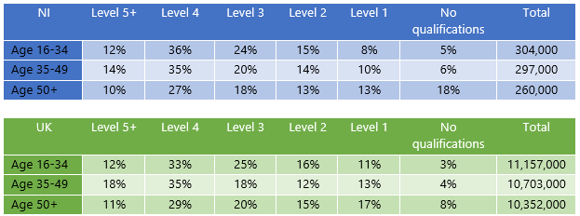
The Skills level of those in employment is changing
Notes:
I touched on it earlier – looking at those in employment, we have essentially parity with the UK averages at younger ages, particularly at higher levels. Over 50 however, there is significant differences, and unfortunately many of those are in jobs, in manufacturing or production, where new technologies are requiring new learning.

Slide 6
Strategy development – work to date
Series of Stakeholder Engagement Events
  Key feedback on needing a whole of government approach to coordinate education, training, labour market, migration, and other policies affecting the development and use of skills.
Research
  Best Practice in Small Advanced Economies
  Strategic Integration of Skills and Innovation Policy
  Skills Barometer
OECD engagement – NIC-ICTU involvement and contribution
Notes:
That provides some of the context for where we are starting from and how the project will be managed. It will also be useful to inform you of what has been done to date.
An initial stocktake and analytical review of Success through Skills was completed to examine progress and lessons learned in 2018 and it highlighted the achievements made, right across government, it improving our skills profile.
This was used to shape a series of stakeholder consultation events held across Northern Ireland last winter, with 300 attendees over the 5 locations.
At the same time, a research project was undertaken to examine the approach taken to the development of skills across the eight small advanced economies identified in the Industrial Strategy, ‘Economy 2030’.
One of the key pieces of research was around skills and innovation.
The Department engaged with Landfall Strategies, who had helped inform the Industrial Strategy on the work of small advanced economies.
One of the key recommendations was for a whole of government approach to coordinate education, training, labour market, migration, and other policies affecting the development and use of skills. This would allow us to better target funding, research and innovation.
In addition they talked about the importance of vocational pathways and the embracing technology – in particular ICT, into all jobs, rather than letting them be relevant only for the IT sector.

Slide 7
OECD Analysis
1
Creating a culture of lifelong learning
2
Reducing Skills Imbalances
3
Effectively using skills in workplace
4
Strengthening the governance of skills policies
Notes:
Many of you will be aware of the work we are doing with the OECD. We have worked with them to identify four areas for research and analysis to help inform the Skills Strategy:
Creating a Culture of Lifelong Learning;
Reducing Skills Imbalances;
Effectively Using Skills in the Workplace; and
Strengthening the Governance of the Skills System.
80% of the 2030 workforce have already completed their initial education and of that group almost one quarter (23%) have low, or no, formal qualifications.
The Skills Barometer forecasts a significant shortfall in the supply of people with skills at the mid, professional and technical levels and an oversupply of people with low, or no qualifications.
Improving performance at level two and improving the provision, and alignment, of mid-level education will be a necessity if we are to reduce such imbalances in the supply of skills.
Providing the right skills is only part of the challenge, how businesses use these skills to drive growth and productivity is another challenge.
There is a need to improve the performance of our firms in areas such as management practice, talent identification and improving the capacity to adapt to change and adopt improved working practices.

Slide 8
Skills Strategy Policy Objectives
Lifelong
Learning
Skills Imbalance
Digital
Skills
Governance
Policy Cohesion
Investment
Notes:
The new strategy will focus on three distinct groups – those in education, those in employment, and those furthest from the labour market, and that’s where out partners, particularly in DfC and DE come in.
As I have mentioned previously, our economy and labour market is changing rapidly. We can no longer rely on a system where education and skills development is finished by the time individuals enter the labour market. To keep pace with the rapidly changing global economy, individuals need to be prepared to undertake learning to update or refresh their skills throughout life. For this to happen successfully, Government, businesses and the education system, must adapt to these changing realities by supporting access and offering relevant opportunities to individuals.
This changing landscape is reflected through the evidence provided by the previously mentioned Skills Barometer for Northern Ireland which demonstrates the current imbalances in the skills and qualifications emerging from our education system. We need to ensure we provide opportunities for more individuals to progress from low level qualifications to the mid-level professional and technical qualifications which are becoming increasing central to our economic success.
At the graduate and post-graduate levels, there is a need to ensure more people are achieving qualifications in the subjects which will be integral to our global competitiveness. These are the skills which can improve research and innovation in the sectors where Northern Ireland has real potential to compete globally and create jobs locally. There is also a need to develop opportunities for knowledge exchange between our businesses, education and research institutions, building their global reputation and marking Northern Ireland out as a centre of excellence.
We need to refresh our approach to the development of digital skills. We need an approach which acknowledges Northern Ireland’s current shortages in the digital sector – which is anticipated to continue to grow rapidly – but also to recognise that digital skills are now vital in every sector of our economy and are rapidly becoming an essential skill for active participation in society.
Underpinning all of this, will be a need to review how the skills system is governed and funded. I have already reflected on how we need to focus on more strategic thinking and collaboration across Government and on how we build stronger, more consistent relationships with you, our key stakeholders, as we implement the new Strategy. Furthermore, if we are to improve our global competitiveness and build a more prosperous society for all, we must consider how we fund the development of education and skills to meet the demands of a small advanced economy in a rapidly changing global environment.

Slide 9
Next Steps
March: Update to DfE Committee on Skills Strategy Development
March: Evaluation of 2011-2020 Skills Strategy published
May: Research on Skills spending across government
June: Final OECD Report
Summer 2020: Publication of Interim Report, for Consultation
Autumn 2020: Final Strategy development, engagement with Board, Committee, Executive
Winter 2020: Formal Launch of Skills Strategy
Notes:
These are some of the key milestones in this project.
The development of the Skills Strategy will run concurrently to the OECD research project. We have established communication mechanisms to ensure OECD finding are communicated to the Project Team on a regular basis and will continue to inform the development of the Strategy.
We are also undertaking analysis of the total investment in skills development throughout NI by Government and have initiated a formal evaluation of Success through Skills to more formally establish and publish the successes and key learning points of the Strategy.
It is vital, if we want to establish an outcomes-focused approach to the skills system that we quantify what goes into it and whether it delivers the outcomes our society requires. This is by no means an easy task and it is something we will likely have to develop over a significant period but it is vital that we begin to get a handle on this aspect.
The final OECD Report is anticipated in June and the Skills Strategy consultation will follow later in the summer.
Allowing for views to be heard and considered, this will lead to a launch of the new strategy late in 2020

Slide 10
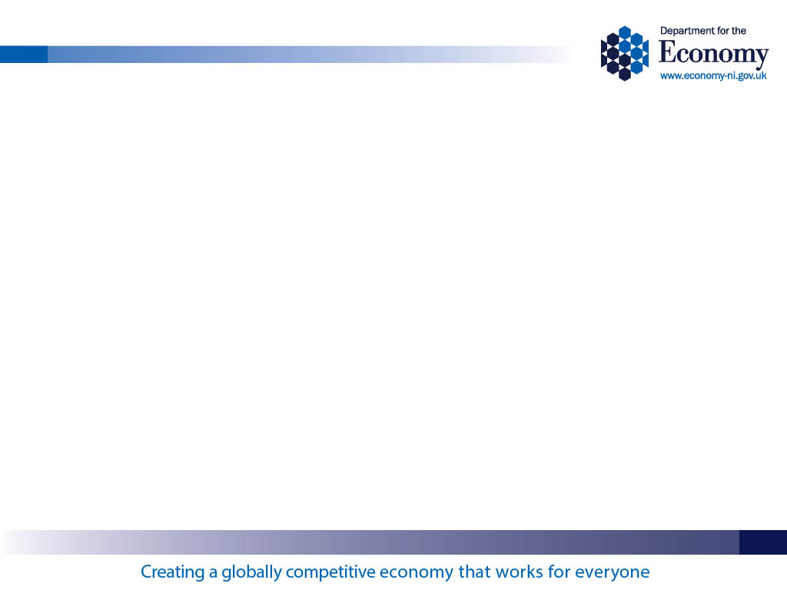
UNION LEARNING FUND CAN HELP
Partnership between central government and the local Trade Union movement
Department for the Economy and NIC-ICTU
Aligns with key policy objectives and strategic themes:
  Lifelong learning
  Re-skilling and upskilling of the existing workforce
  Addressing skills imbalance
Notes:
Partnership and Collaboration
Strategic Alignment
Representative of the main employment sectors throughout NI

Slide 11
UNION LEARNING FUND CAN HELP
Enables NIC-ICTU and its member unions to have a say in future skills policy development;
Working with local FE colleges and other training providers, ULF can help deliver targeted training and qualifications at all levels, but with a particular emphasis on Entry Level, through to Level 2 and 3;
Building strong and positive relationships with between staff representative bodies and employers, which benefits everyone.
Notes:
Upskilling of the workforce – to enable progression within a current job role, or the potential to advance an individual’s career through the achievement of skills and qualifications – the lightest thing that you will ever carry around with you!
It is also supporting our local employer base – helping them to retain staff, become more productive, and therefore more competitive in their market, be it local national or international.
Applies across all sectors of employment – Public, Private, C&V……..
Also, work with large and small scale redundancies can help prevent people from falling out of work by securing new employment very quickly, avoiding the risk of becoming unemployed or economically inactive.

Slide 12
ULF – Looking Forward
Continue with the renewed emphasis on relevant accredited qualifications, including Essential Skills;
Greater partnership work with the six regional FE Colleges, and look for opportunities to compliment existing provision and programmes;
Consider specific skills areas, and levels of qualifications, in line with those that feature in the new Skills Strategy, and that will support growth sectors of employment;
Regular and ongoing communication with departmental officials to monitor ULF performance and achievements against the agreed targets.
Notes:
Occupational areas:
Hospitality
Health & Social Care
I.T.
Call Centres
Agri-Food
Construction
Retail

Slide 13
Thank you.

