Slide 1

Matching skills needs with skills reserves:
Protecting workers and communities for a Just Transition.
10th March 2020
Union Learning Conference 2020
Newtownabbey
Paul Goldrick-Kelly Twitter: @PaulGK_NERI
EMAIL: paulgk@nerinstitute.net
WEBSITE: www.nerinstitute.net

Slide 2
Introduction
The island of Ireland has an emissions problem:
  ROI emissions amount to 13.3 tonnes of CO2 equivalent per head.
  NI a better performer but emissions of 10.7 tonnes are well in excess of EU28 average 8.8 tonnes and EU best Sweden at 5.5 tonnes.
In ROI, a big part of the problem is compositional.
Emissions are not entirely separable given links

Slide 3
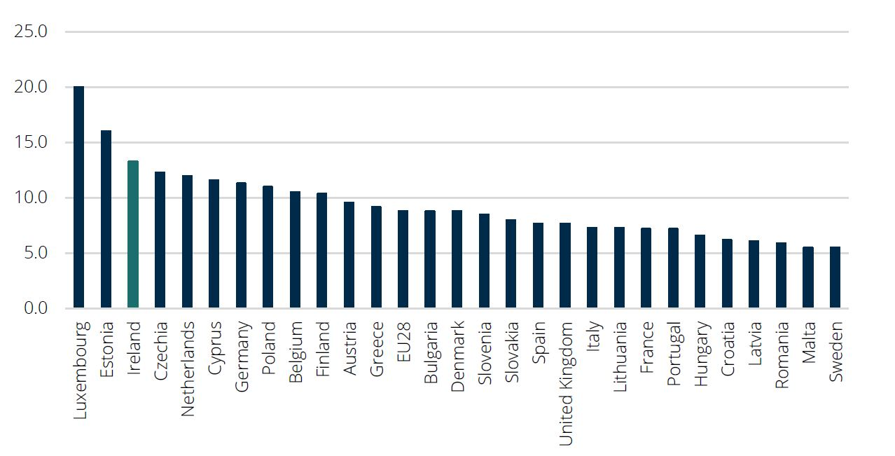
Tonnes of emissions Carbon Dioxide Equivalent per capita 2017

Slide 4
Introduction continued
A “Just Transition” states that at-risk communities and workers should not bear the burden of adjustment.
This entails a stronger role for government.
A Just Transition incorporates many elements.

Slide 5
Where are at risk jobs concentrated?
A proactive policy approach should try to identify the workers and communities at high risk.
One method we use in our ROI analysis is an examination of carbon intensities of different economic sectors.
We observe high concentrations in 6 sectors – they account for less than a tenth of employment but nearly 90 per cent of emissions.

Slide 6
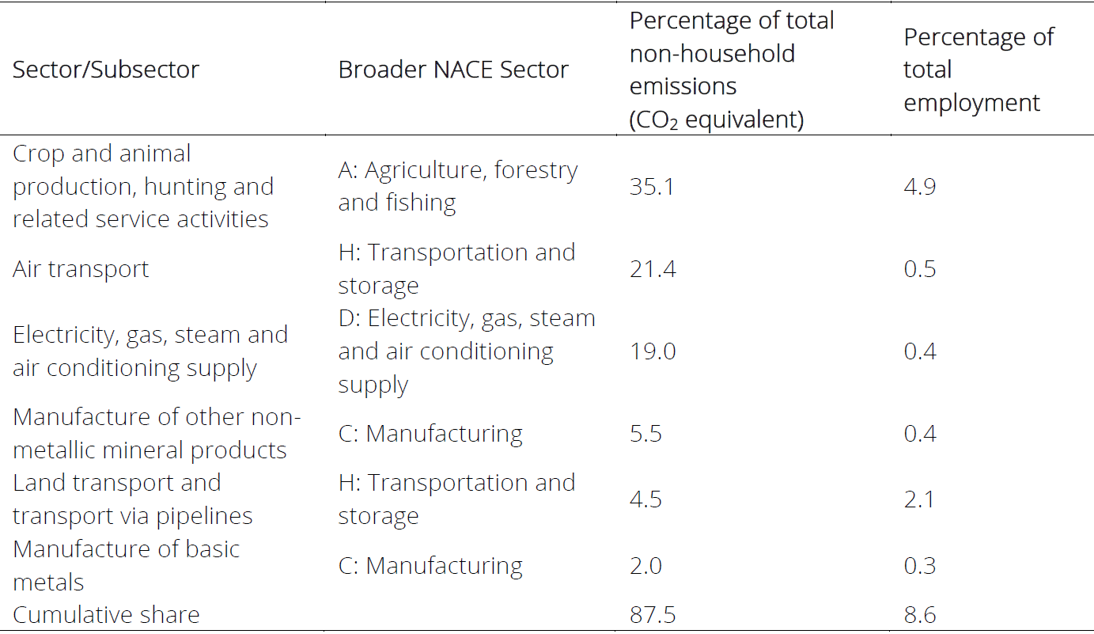
Proportions of emissions and employment by sector ROI 2017

Slide 7
The skills challenge of transition
Defining “green jobs” and skills is complicated and various definitions are used.
However, “green jobs” seem to value STEM, Administration and Business qualifications.
There is evidence of significant skills mismatch in the ROI economy in comparison to other EU countries, both horizontal and vertical. Horizontal mismatch more the issue in NI (MacFlynn, 2017).

Slide 8
Matching the skills of workers in at-risk sectors and the potential labour supply
Data is limited here, but LFS offers a picture of some at risk sectors.
There is substantial variation in the skills profile of these sectors. Some sectors are better equipped for transition – like Electricity , gas, steam and hot water (BnM, ESB)
Some less so (Crop and animal production)

Slide 9
Matching the skills of workers in at-risk sectors and the potential labour supply
Opportunities: Examining a broad measure of labour supply PLS4 we also observe unutilised skills in this population in ROI*
Turning to selected regions, we identify a varied regional picture.
Worryingly, ROI displays low levels of in-job training, higher ed funding and a fraction of former apprenticeship levels. UK wide stats also point to low in job training rates.
*actually higher in Q2 2019 than Q2 2016 according to CSO

Slide 10

Continued…

Slide 11
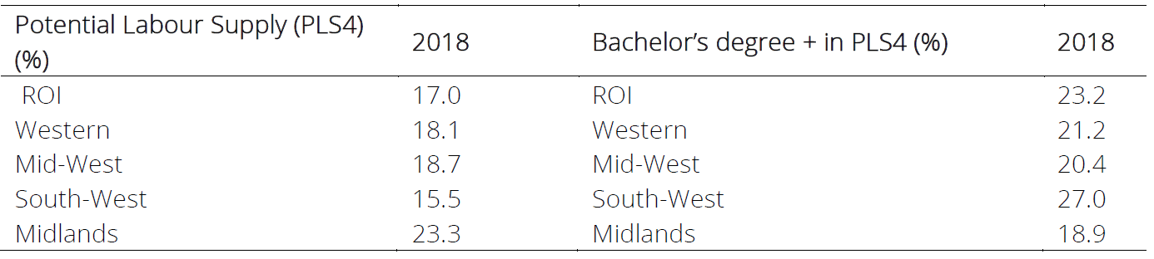
Highly educated and inactive

Slide 12
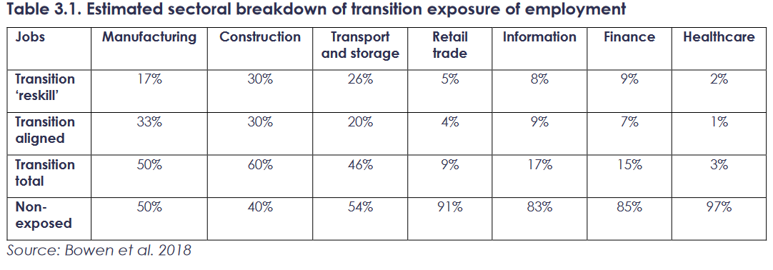
Skills Demand for the green economy UK

Slide 13
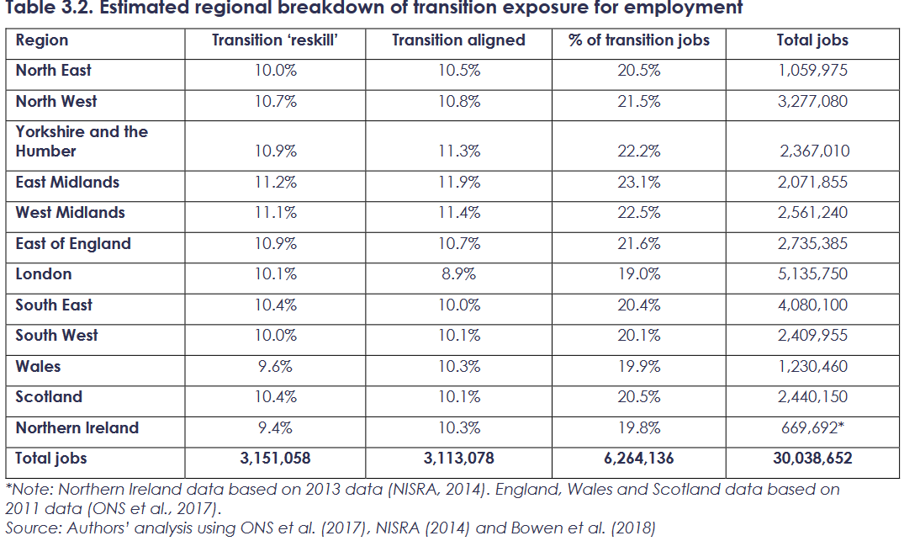
UK regional picture
(Robins et al., 2019)

Slide 14
Lessons for managing transition
There are successful and unsuccessful examples of transition experience.
International lessons include:
  Agreed Transition timelines through meaningful social dialogue. This allows for pro-active as opposed to reactive policy responses.
  Inclusion of local bodies in planning – various levels of government, local actors.
  Labour market institutions for upskilling, eg. Swedish job security councils.
  Social security important elsewhere.
  Public investment for infrastructure and to support high skilled labour demand.

Slide 15
Policy recommendations from our paper
Strategic planning and implementation:
  High level bodies serve a purpose and must coordinate to meet the GHG challenge. Includes EU, national authorities and others.
  High level planning and carbon targets are appropriate but local engagement is needed to avoid top-down pitfalls.
  Institutions to reflect and negotiate between workers, employers are not an impediment to success. Co-ordinated market economy institutions appear to fare better.
  The government should shape skills demand, rather than adopt a reactive approach.
The social insurance system is underdeveloped in ROI, €11 billion extra if we collected at peer rates. This could help address limited in-work upskilling.

Slide 16
Matching skills needs with skills reserves:
Protecting workers and communities for a Just Transition.
10th March 2020
Union Learning Conference 2020
Newtownabbey
Paul Goldrick-Kelly Twitter: @PaulGK_NERI
EMAIL: paulgk@nerinstitute.net
WEBSITE: www.nerinstitute.net

